Slide 1
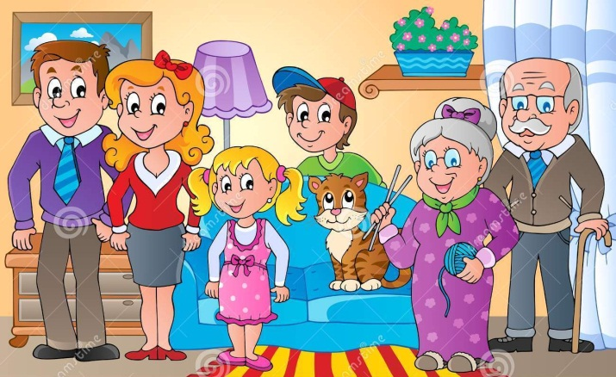
A family

Slide 2

A mother

Slide 3
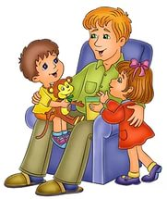
A father

Slide 4
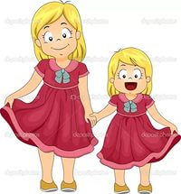
A sister

Slide 5

A brother

Slide 6
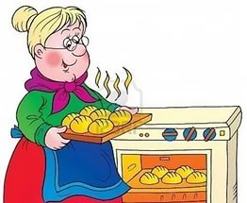
A grandmother

Slide 7
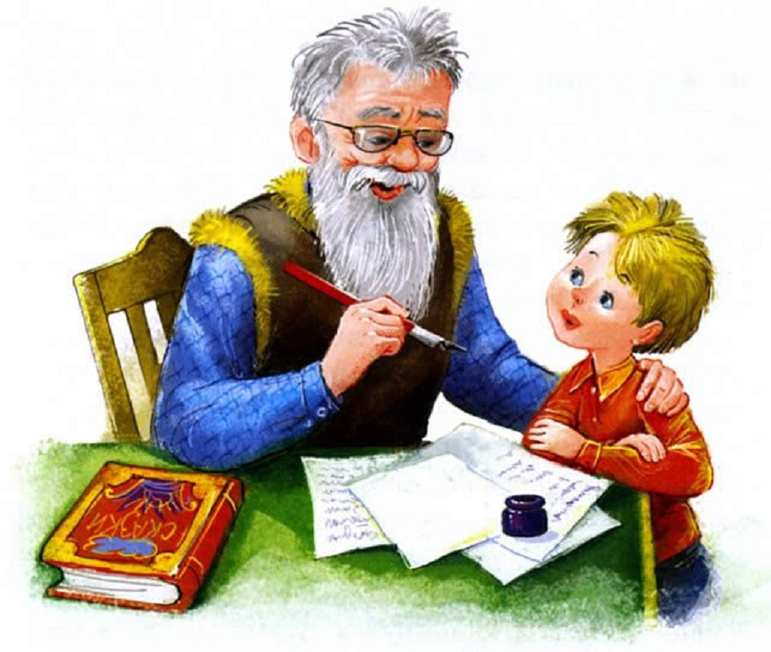
A grandfather

Slide 8
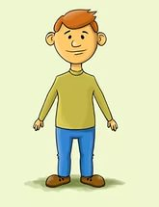
An uncle

Slide 9

An aunt

Slide 10
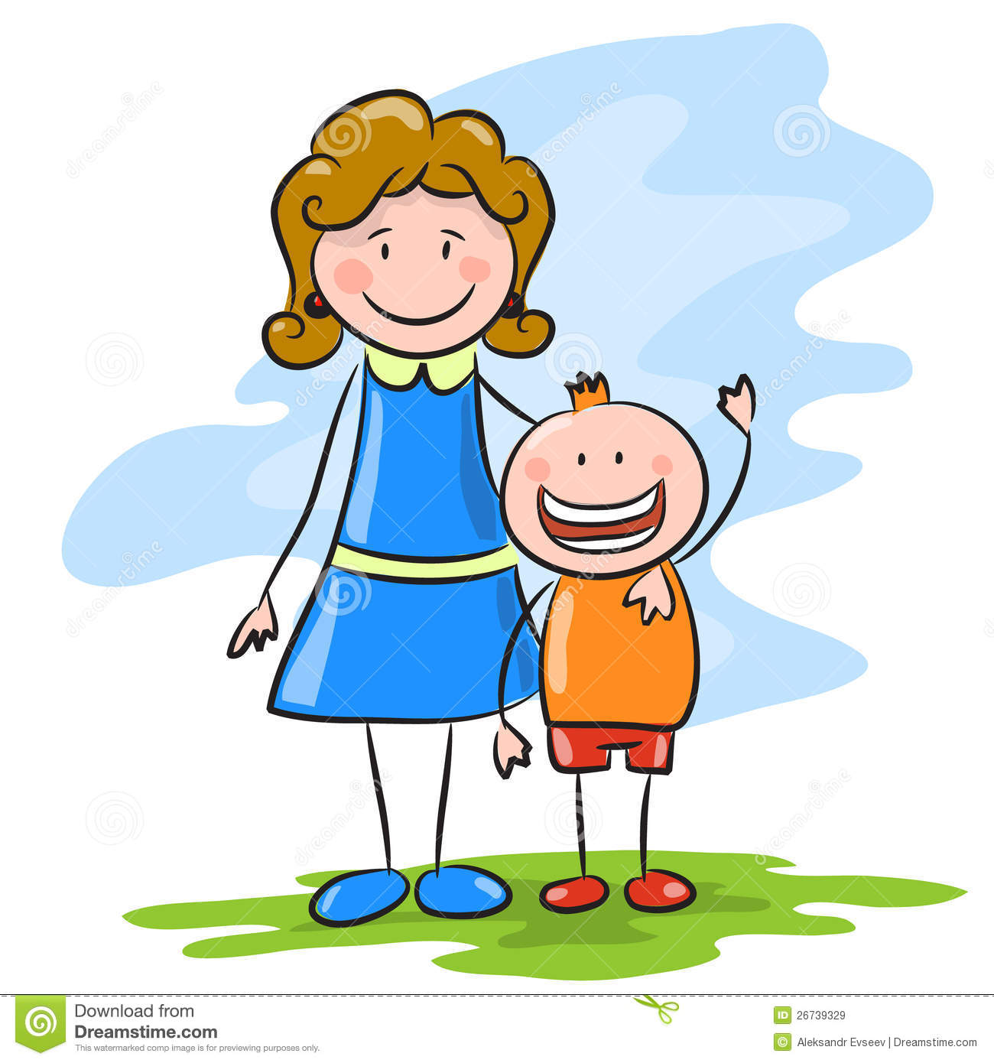
A son

Slide 11

A daughter

Slide 12
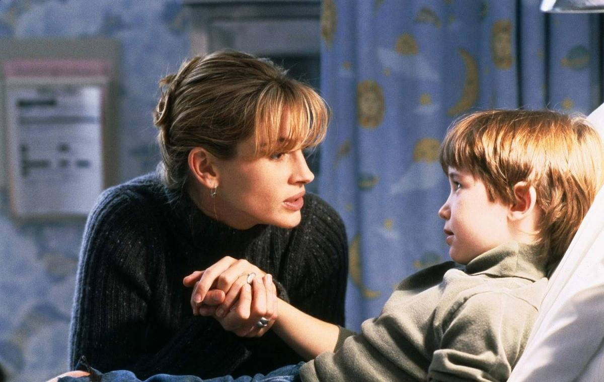
A stepmother

Slide 13

A stepfather

Slide 14
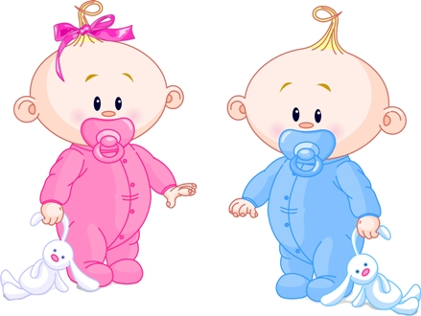
Twins

