Slide 1

Презентация
«This is my school.»
Составила: Щепина В.В
Учитель английского языка

Slide 2

приветствие

Slide 3
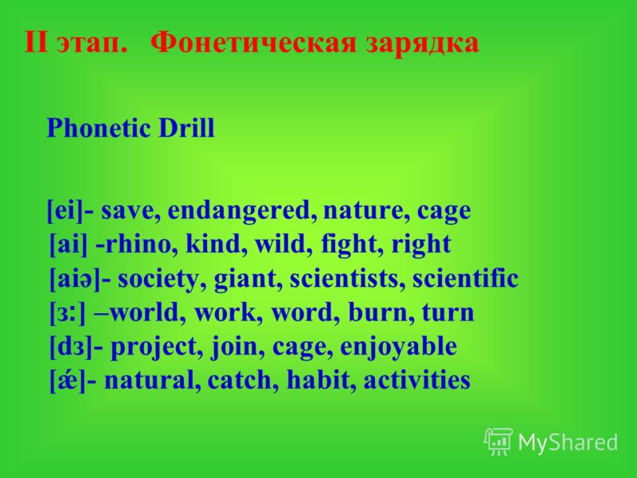

Slide 4
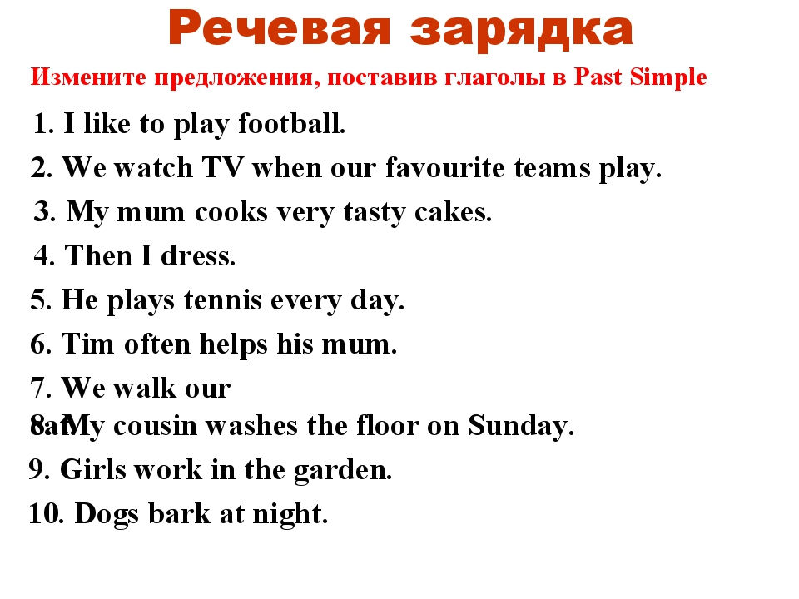

Slide 5
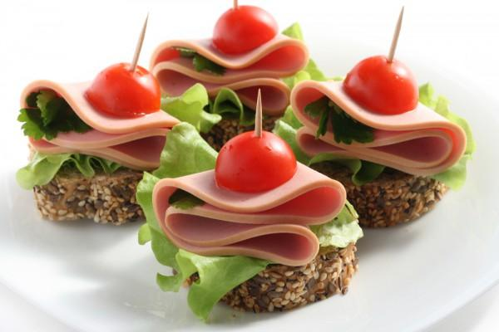
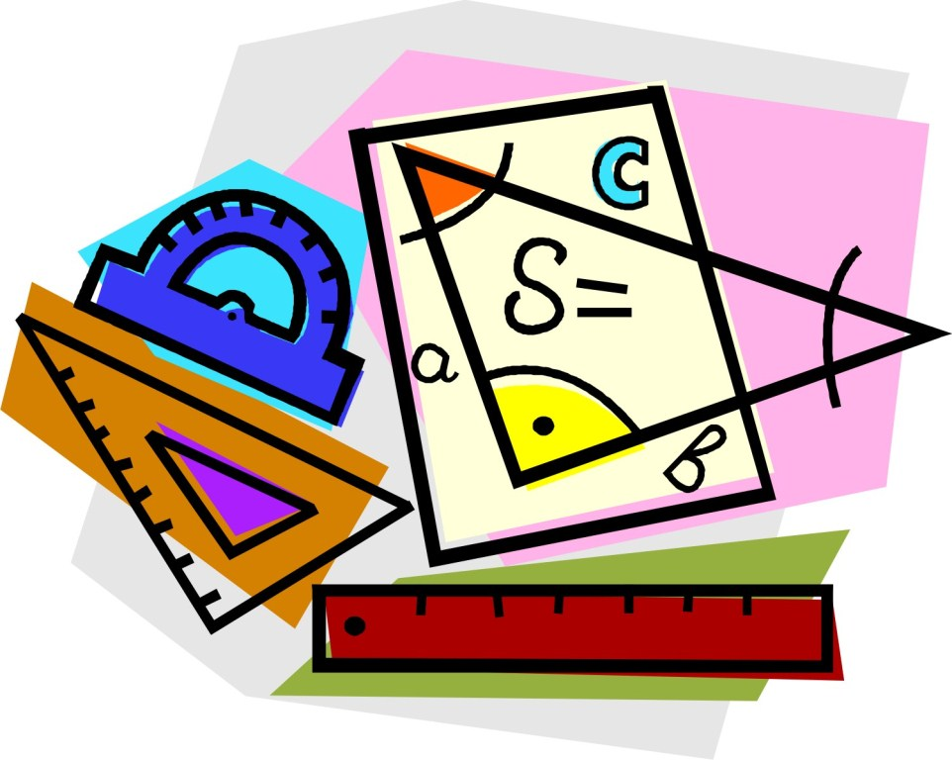


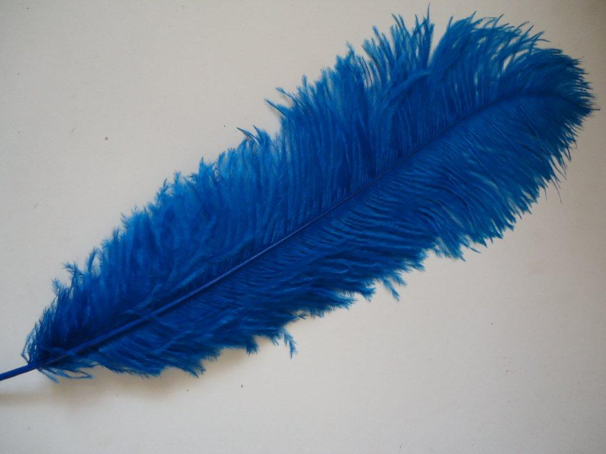
A subject
[ ˈsʌbdʒɪkt ]
A snack
Art
easy
PE

Slide 6

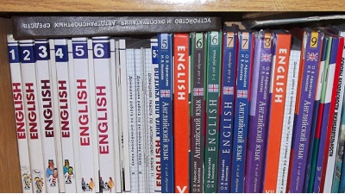

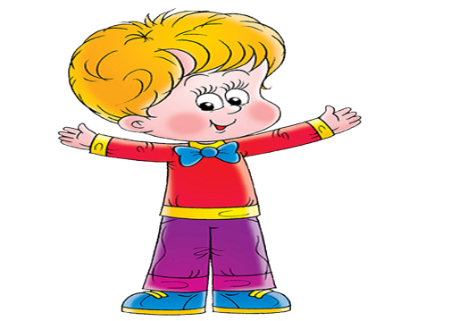
EX.1 P50
I go to school every day. Here is my school day: school starts at 8:55 am. My lessons starts at 9:20 am. At 10:20 am we have break time. After break time we have one lesson. At 12:00 am we have lunch time. We eat snacks that we bring from home. In the afternoon, lessons start at 1:10 pm and at 3:15 pm we go home. My favourite subjects are Music and Art. I find English lessons easy. Science is easy, too. And I’m good at PE. But I hate Maths lessons , homework and tests!

Slide 7
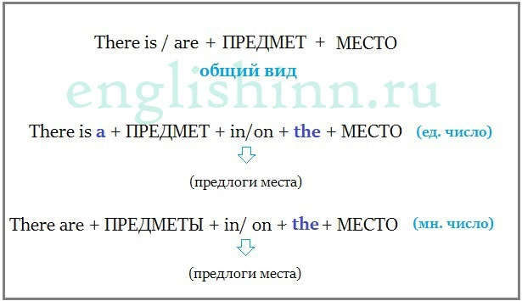
Обороты there is/are

Slide 8
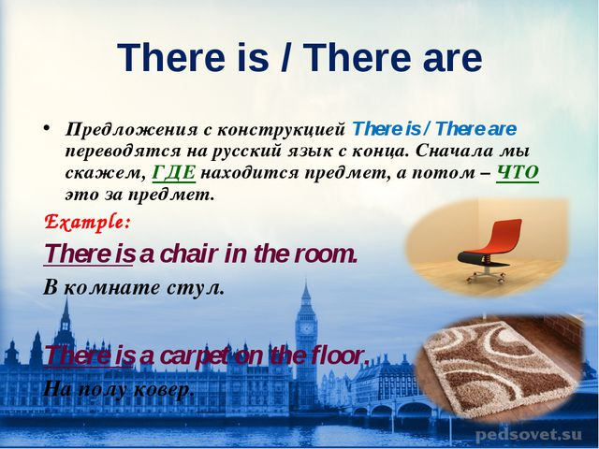

Slide 9
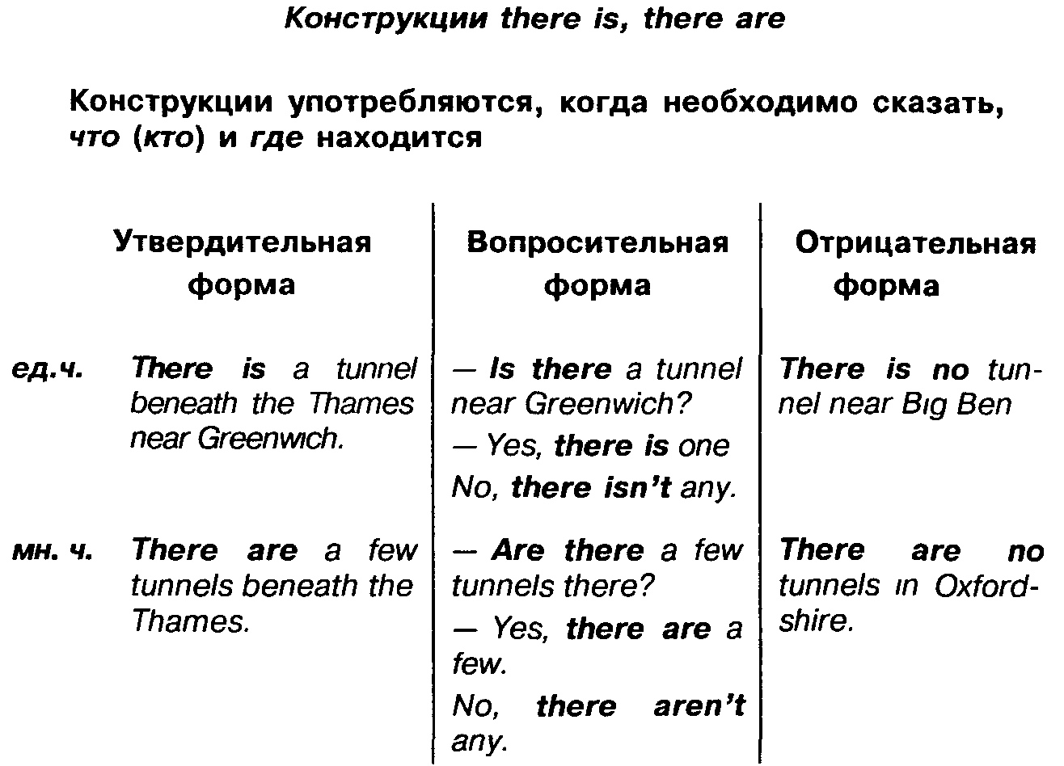

Slide 10
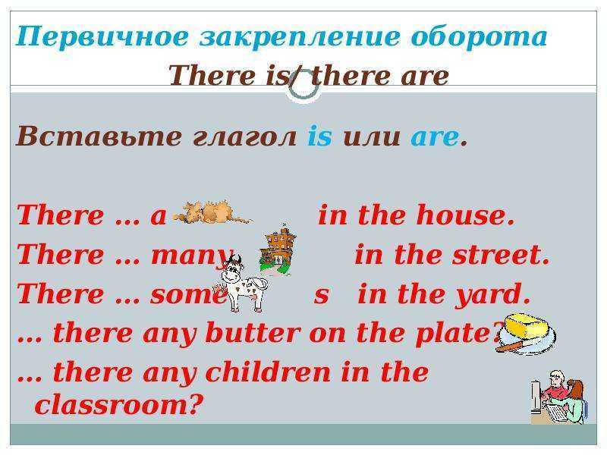

Slide 11
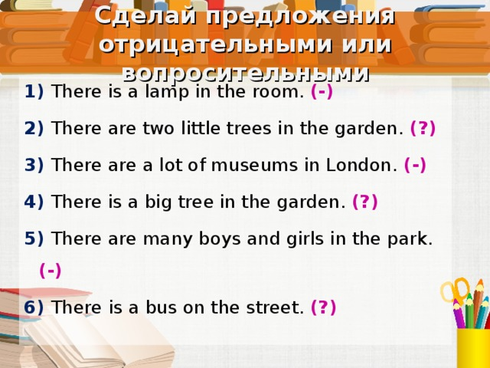

Slide 12

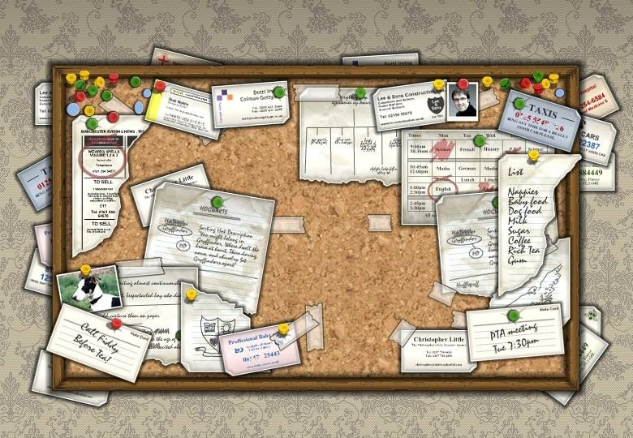


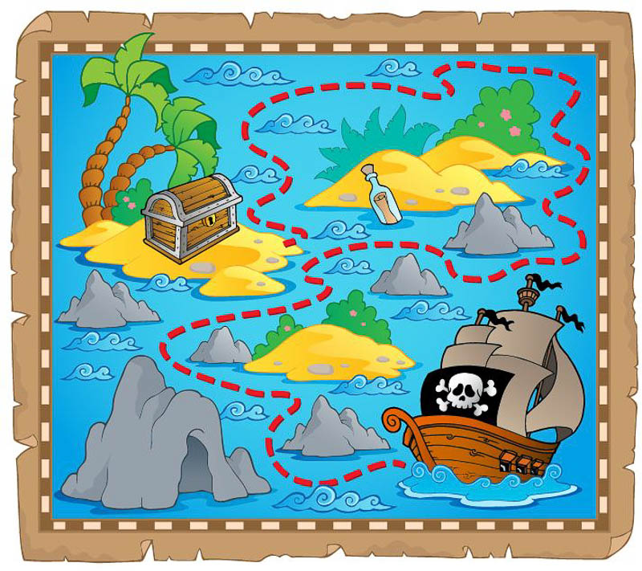

classroom
The noticeboard
The pupil desk
The board
[nəutɪsbɔ:d]
The map
The computer
The teacher’s desk

Slide 13

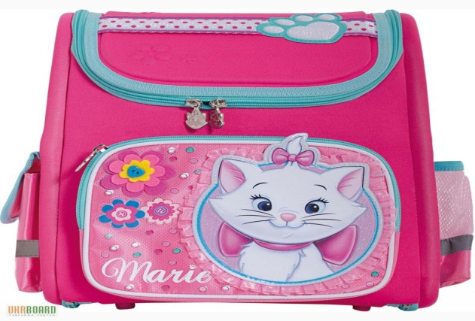
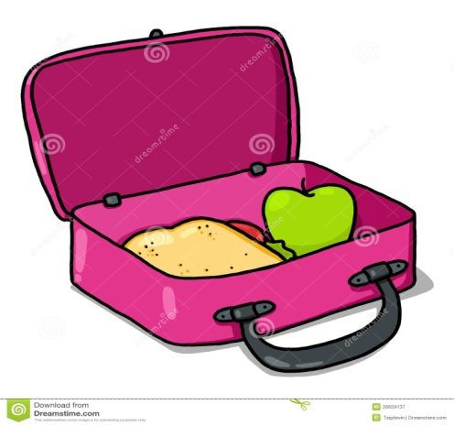

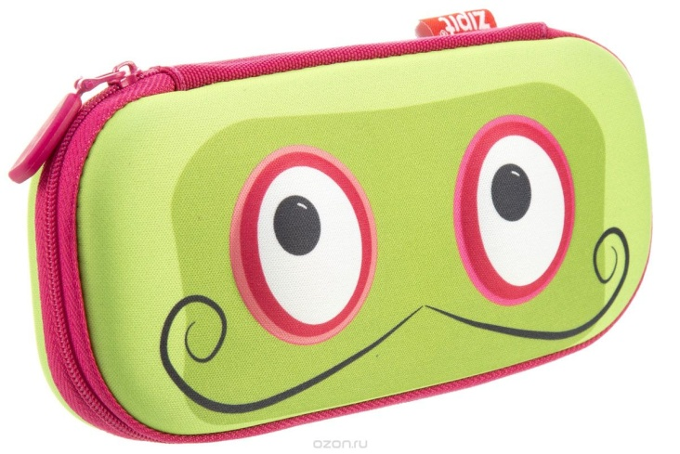

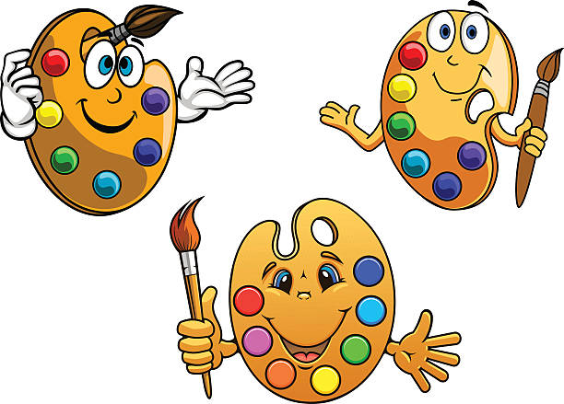
school supplies
School bag
A pencil
A pencil case
lunchbox
paints
A ruler
A pen

Slide 14


Slide 15
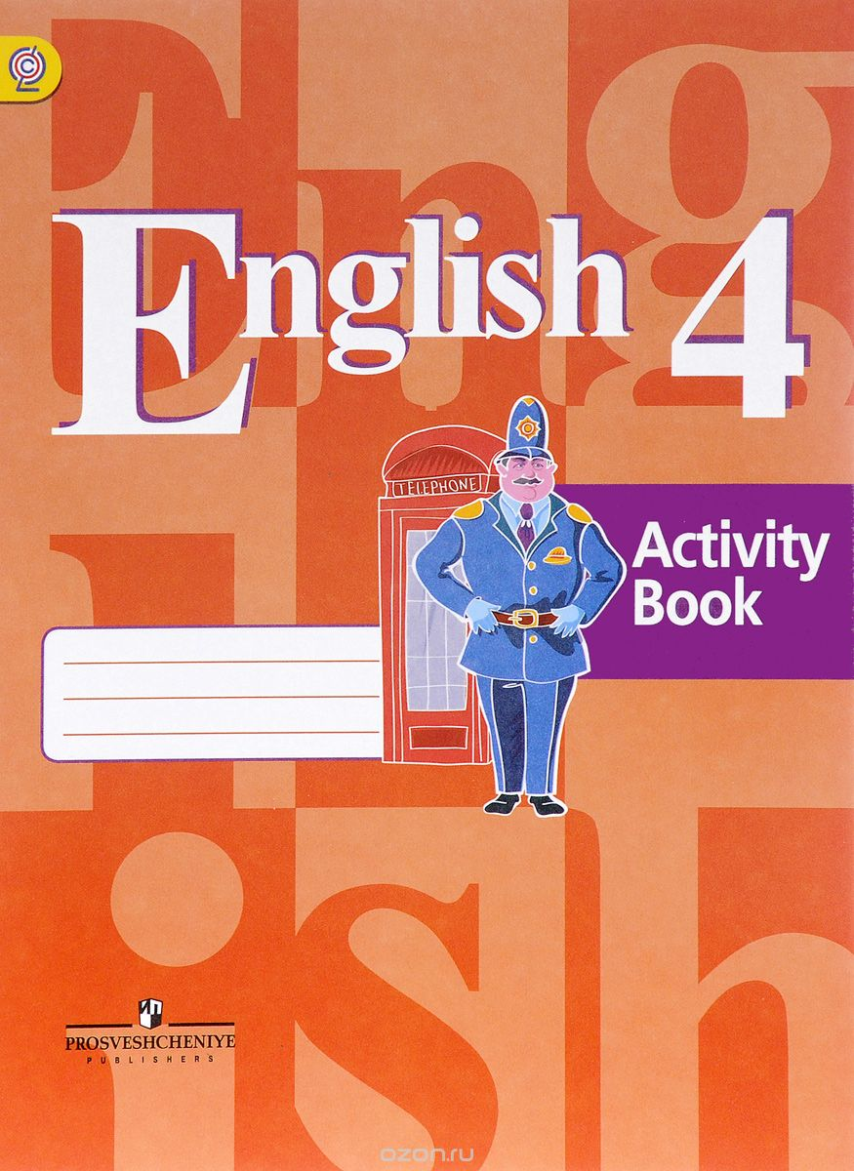
Выполнение упражнений по теме

Slide 16


Ролевая игра (назовите предмет)

Slide 17


Slide 18
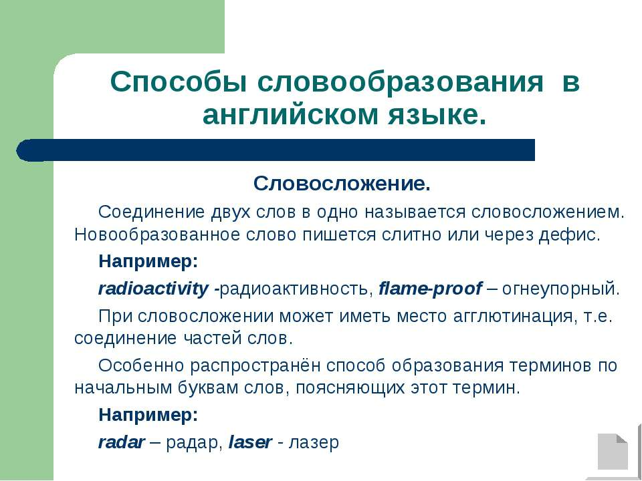

Slide 19


